Slide 1
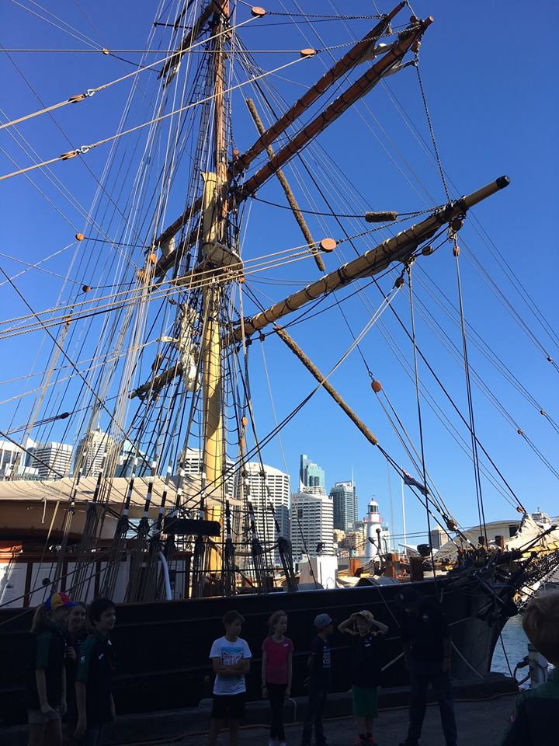
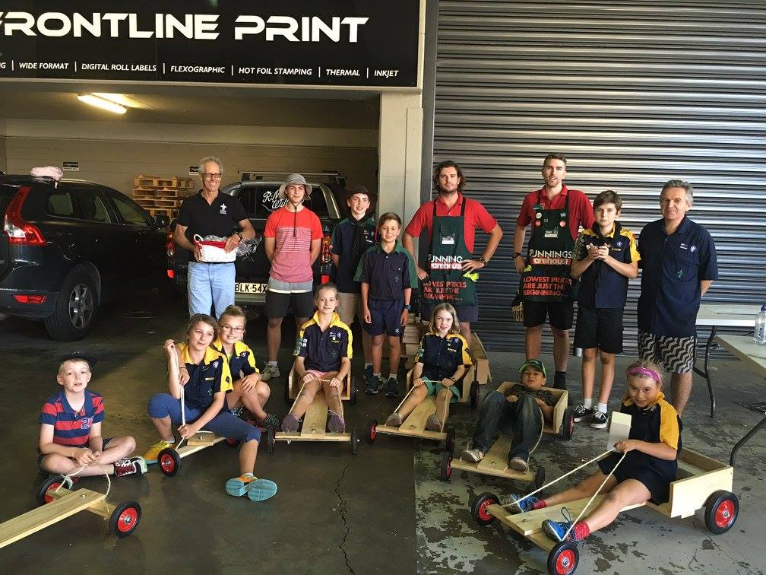
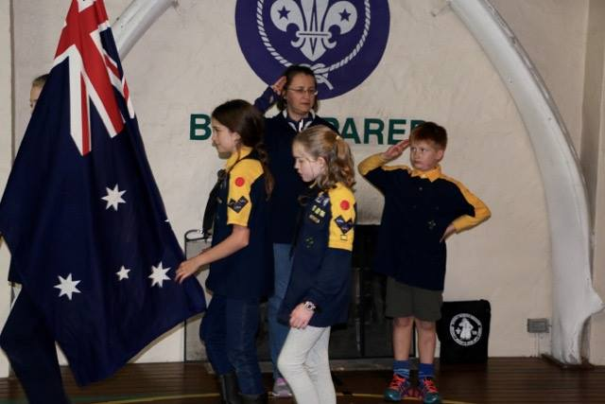
Group Plan
2015
1st Mosman 1908 Scout 2017 Group Action Plan
Sydney North Region

Slide 2
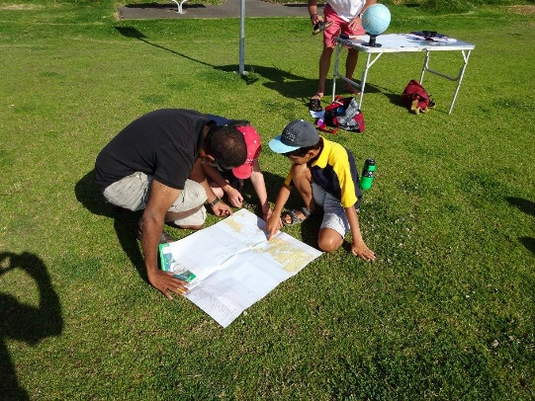
Key Outcome 1: To be recognised as contemporary and a relevant organisation
Targets
To offer relevant, exciting programs for Cubs, Scouts and Venturers throughout the year.
To participate in Regional opportunities as appropriate
To promote 1st Mosman Scouts within Mosman region.
To have appropriately trained leaders
To build a supporting team of volunteers.
Actions
2017
Group Council
To meet at least once a term
To have a strong weekly activity program
To have a clear, consistent and regular communication program
Group Committee
To meet at least once a term
To manage our affairs professionally and efficiently
District or other party
To support District activities as appropriate
To attend meetings
To keep the Census up-to-date
To abide with the rules and regulations
Measures of success
To have a stronger Group at the end of 2017 measured by a minimum of 10 Cubs, 10 Scouts and 7 Venturers
To be financially viable
To have positive feedback from Cubs, Scouts and Venturers, parents and Leaders.

Slide 3
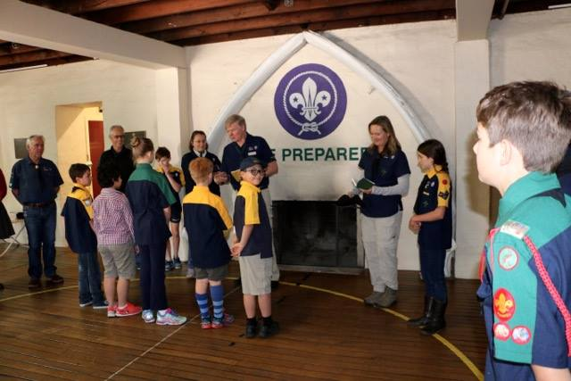
Key Outcome 2: To have well trained, well resourced and passionate leaders
Targets
Ideal target would be a minimum of 2 qualified leaders for each section.
At the 2016 stocktake, the indication was that more smaller tents are required as quite a few are missing bits and pieces. Apart from tents the Group is very well resourced especially with watercraft.
Actions
2017
Group Council
All leaders to complete an Adult Development Plan- regardless of their level of training
Group Committee
Invite all Leaders to Committee meetings.
District or other party
Not applicable
Measures of success
The number and functionality of tents meets with the approval of the Leaders.

Slide 4
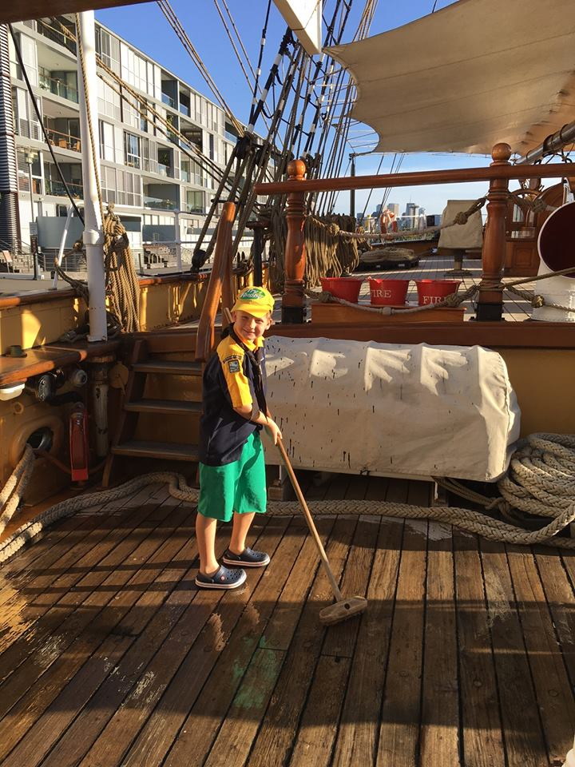
Key Outcome 3: Delivery high quality and consistent youth programs
Targets
Have a minimum 20% of Cubs achieve the Grey Wolf award. With the balance achieving at least 3 badges.
Have a minimum 20% of Scouts achieve at least one of the three Cords. With the balance achieving at least 3 badges.
Participate in Sirius Cup and the Regional Scout Hike
Actions
2017
Group Council
Leaders to table results each term.
Group Committee
Not applicable
District or other party
Not applicable
Measures of success
Achievement of all three targets above

Slide 5
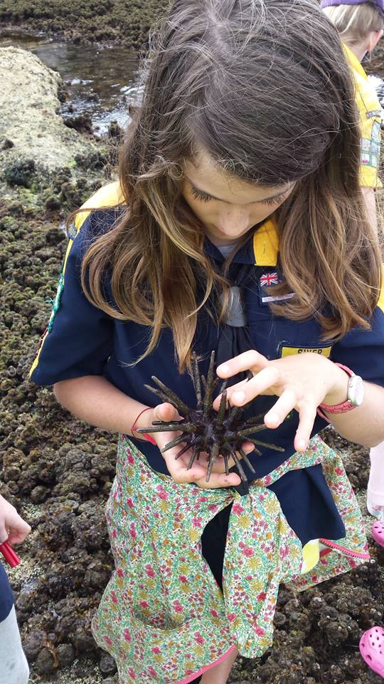
Key Outcome 4: Establish strong and contemporary partnerships
Targets
Continue to build relationships with HMAS Penguin, the Mosman Council and local police.
Adopt a firm but fair relationship with neighbours around the Barn.
Review other opportunities
Actions
2017
Group Council
Not applicable
Group Committee
Renew 5 year licence with HMAS Penguin
District or other party
Not applicable
Measures of success
No reasonable complaints from our partners during the year.

Slide 6
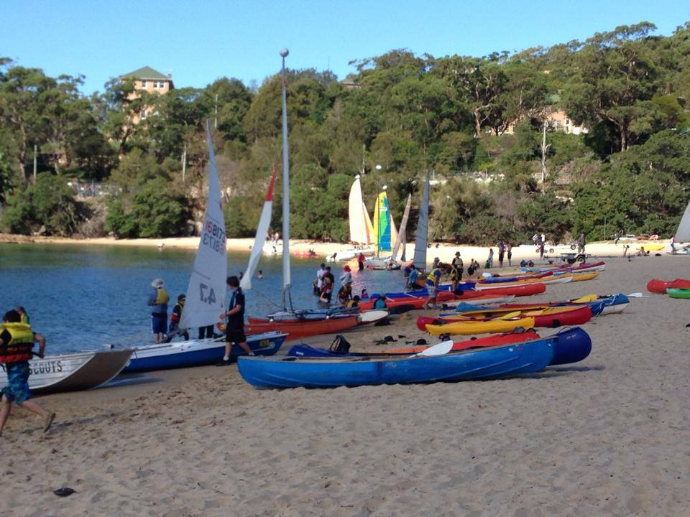
Key Outcome 5: To be a well governed, effective and agile organisation
Targets
For the Committee to meet at least once a term
For minutes, asset registers and other requisite forms be completed as per Scout standards.
For all invoices to be paid within 30 days.
To comply with 1st Mosman protocols and standards.
Actions
2017
Group Council
Not applicable
Group Committee
Constantly monitor that appropriate actions are taken and recorded in the Minutes.
District or other party
Compliance as per Scouting standards.
Measures of success
1. Positive feedback from Sydney North Region Office.
2. Stronger community partnerships with suppliers.

Slide 7
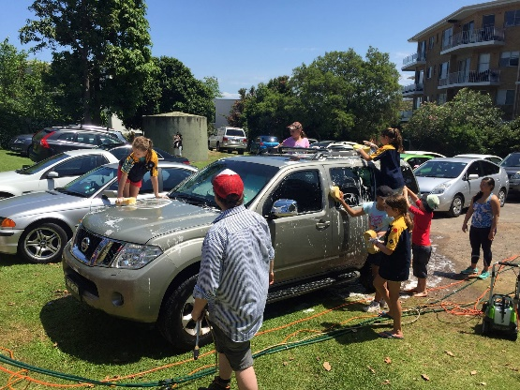
Key Outcome 6: To be financially robust and sustainable
Targets
To be a financially viable organisation at all times
To have the appropriate checks and balances in place
To meet designated deadlines.
Actions
2017
Group Council
Not applicable
Group Committee
Change banks and simplify payments
Regularly review the Treasurer’s Variance report and take appropriate action if required.
Install new children's kitchen at the Barn.
Renovate Freeston Hall with repairs and paint.
District or other party
Not applicable
Measures of success
Achieve the above targets

Slide 8
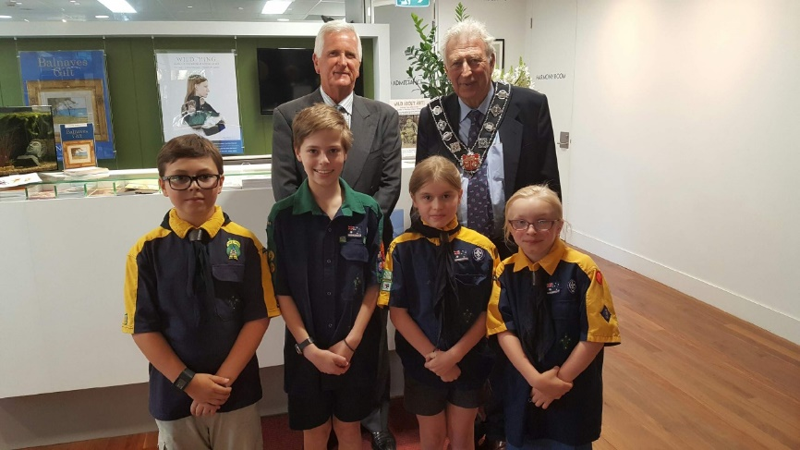
Key Outcome 7: To be a technology savvy organisation
Targets
To continually improve our website communications
To use Trybooking for subscriptions, events, Hall hire etc
Actions
2017
Group Council
Not applicable
Group Committee
To continually monitor and if necessary improve on existing technical support.
District or other party
Not applicable
Measures of success
To have parents using the website 90% of the time for Scout information/payments/hall bookings etc

Slide 9
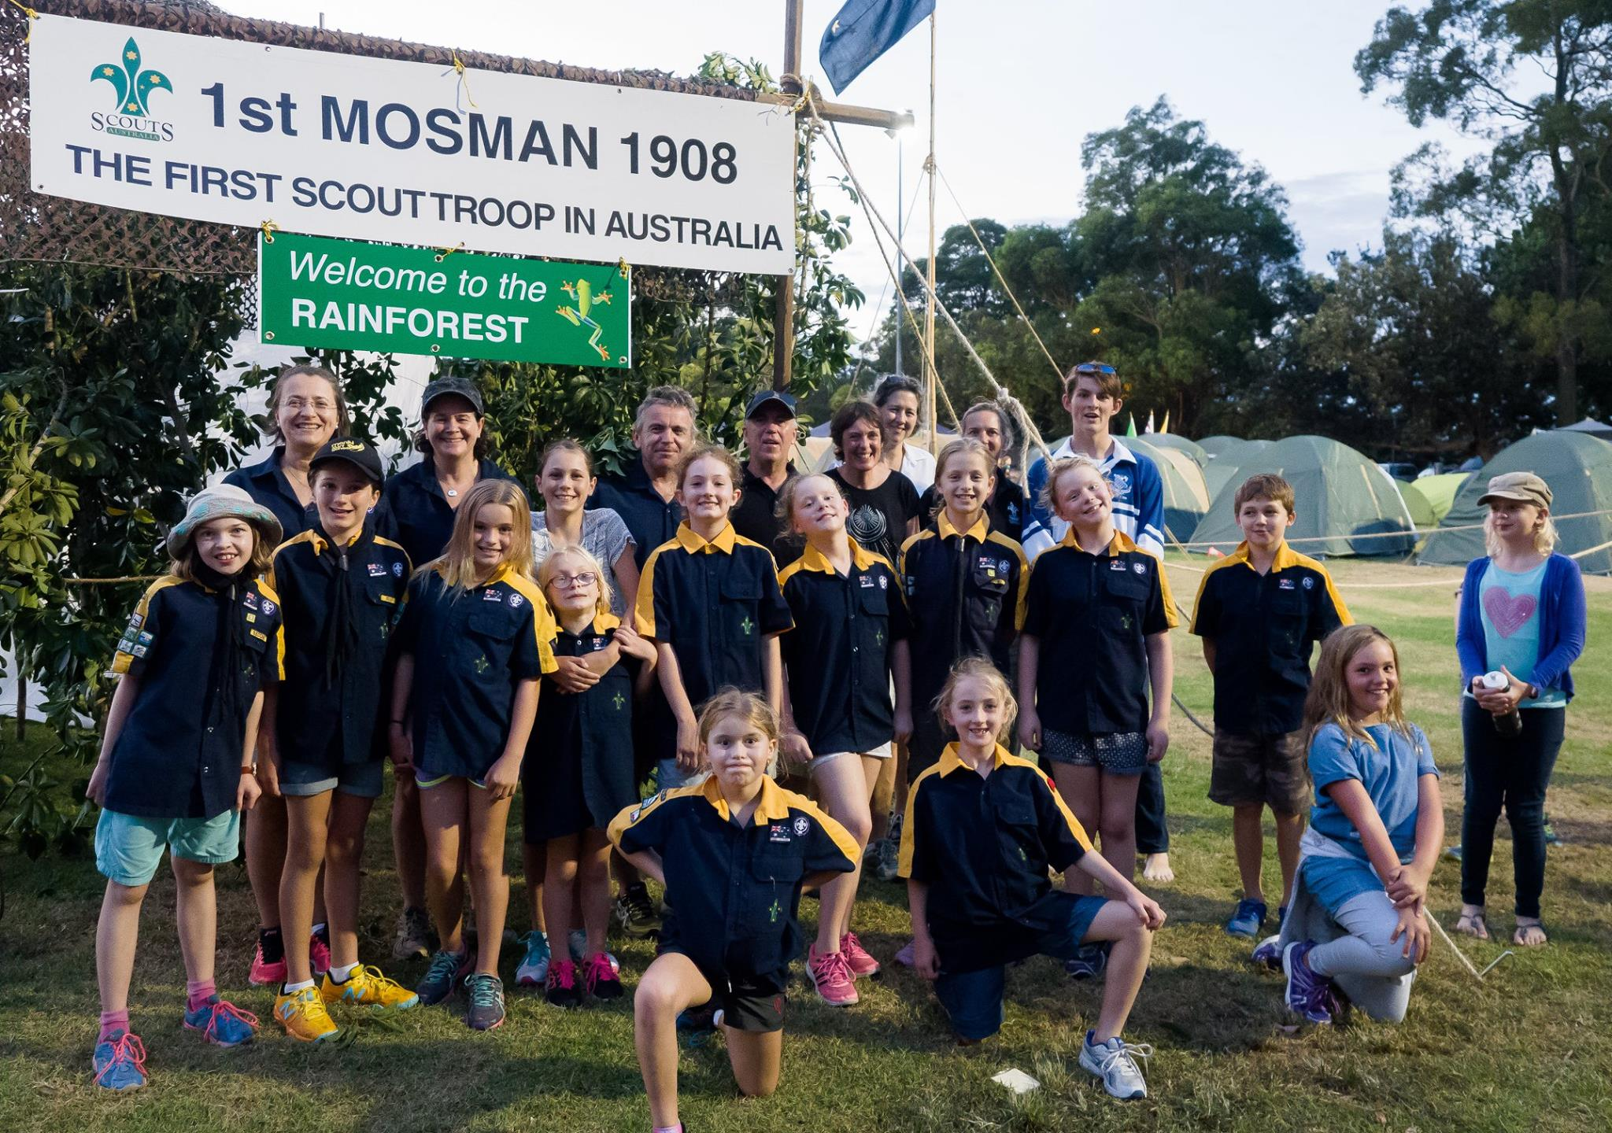
Baseline measures - 2017
Build Cub and Scout groups to 10 + members
Achieve at least 2 trained Leaders for each Section.
Achieve positive and regular feedback from Cubs, Scouts and Venturers on the programs offered each week

